Slide 1

Program/Supplier Name
Source Review Board
Presented by NAME
Date
***Everything in RED Font should be updated to the respective program and changed to BLACK Font***

Slide 2
Sourcing Board: | Program Name
Agenda
COS Project Information
Supplier Information
RFQ Assumptions: COS only
Quotation Analysis and Summary: COS only
MVA Analysis
Capex: when required
Mechanical Piece Price Comparison
Recommendation
Approval
PCR data/format can be used throughout appropriate sections of this deck (to avoid duplicate work).

Slide 3
Supplier / Program Name – Project Overview
Project Executive Summary
Scope | Category
Current Supplier(s), SOC Status, and Spend | Prince, SEG, $5M
New Supplier(s): SOC Status. Spend | Mallory, Niche, $
# of parts by plant | 50 parts El Paso, 20 parts Hopkins
Part Criticality (COS only) | Level 5 = 5 parts, level 3 = 45 parts,
Product Lines Impacted (LoB’s/BU) | LV Swbd’s/B&E/Power Products
Manufacturing Strategy (COS Only) | NEC/MEC, Internal/External, Where
Pre-BoC Blitz/Review Completion date (CoS Only) | (DATE)
Schedule
RFQ/Benchmark (Nego) Completion | (DATE)
Nego Date/BoC Presentation | (DATE)
Estimated Open Date | (DATE)
Estimated P&L Impact Date | (DATE)
Pictures of Parts, products..
Description: Change of supplier from
A supplier to B supplier. In this business
case it is reflected eight part numbers
with two and three poles…
Justification: Risk, productivity, etc..
Project Benefits/ Estimated savings:
Funding support:
LoB / Global GSC / GSC China / others
Project Risks: If Any risk identified

Slide 4
Supplier comparison
PACE
MES
Location Classification | USA Authorized/ Validated
ESSR | 100%
S-DPM | 435
SE Plants | Monterrey 3, Lakeforest CA, Foxboro, M&I Reynosa
Location Classification | China + Warehouse in MTY Authorized/ Validated
ESSR | 100%
S-DPM | 390
SE Plants | Monterrey 3, Clovis, Lakeforest CA, Reynosa
SUPPLIER PERFORMANCE
Yearly spend (USD) | $ 1.6 MUSD
Terms of Shipment | Ex Works Boston, MA
Payment Terms | 45 days
MOQ | 2000, 3000, 5000, 10,000
Standard Lead Time | 16 - 35 w/days
PO Condition | Blanket PO based on MOQ (Change of MOQ impact on Price)
Yearly spend (USD) | $ 1.5 MUSD
Terms of Shipment | FOB Mty Warehouse
Payment Terms | 75 days
MOQ | 300, 400, 500, 1000, 2000
Standard Lead Time | 7 w/days
PO Condition | Based on established MOQ from plant.
QUOTE TERMS

Slide 5
Supplier Assumptions: Program Name
Spend Volume Estimate: 200K+ annual starting Q3-2018.
CAD Models, drawings, specifications for the parts can be found in the following Box Folder: (insert link)
Incoterms: (COS Only) FCA SHA for Jabil and FCA Shenzhen for Flextronics. EMS to hold title while product is in transit to ship point ABC USA. SE Factory is ex-works Location ABC with SE holding title in transit.
MSA: Y/N Expiration Date: 1/1/20
For COS: % growth for receiving supplier, forecasted savings on legacy spend (P/L impact),
Current SE (US Spend), New SE (US Spend)
Productivity agreement or for Nego with New supplier?
SRIM: Green
SAM Audit Score (and date of completion): Green
Core Tech Verification (date):
Supplier Process: List supplier process already validated

Slide 6
Quotation Analysis: Program Name
 | PROGRAM
 | Date |  | Date
 | EMS |  | EMS |  | Comments
Commodity | Q1'18 Ext. Cost | Q1'18 2nd Sourced Ext. Cost | Q1'18 Ext. Cost | Q1'18 2nd Sourced Ext. Cost
VLSI | $0.00 | $0.00 | $0.00 | $0.00
Memory - DRAM | $0.00 | $0.00 | $0.00 | $0.00
Memory - FLASH | $0.00 | $0.00 | $0.00 | $0.00
Antennas | $0.00 | $0.00 | $0.00 | $0.00
Power | $0.00 | $0.00 | $0.00 | $0.00
Plastics | $0.00 | $0.00 | $0.00 | $0.00
Metals | $0.00 | $0.00 | $0.00 | $0.00
Diecut | $0.00 | $0.00 | $0.00 | $0.00
DLL | $0.00 | $0.00 | $0.00 | $0.00
Hardware | $0.00 | $0.00 | $0.00 | $0.00
Interconnect | $0.00 | $0.00 | $0.00 | $0.00
Manuals/Packaging | $0.00 | $0.00 | $0.00 | $0.00
Passives | $0.00 | $0.00 | $0.00 | $0.00
PCB | $0.00 | $0.00 | $0.00 | $0.00
Switches/Controls | $0.00 | $0.00 | $0.00 | $0.00
RP Roll Up | $0.00 | $0.00 | $0.00 | $0.00
TK Roll Up | $0.00 | $0.00 | $0.00 | $0.00
DM Cost | $0.00 | $0.00 | $0.00 | $0.00
VA Cost
Incoming Freight
SOI
Total Cost (DM + VA + Incoming Freight) | $0.00 | $0.00 | $0.00 | $0.00
RFP Cost Assumption
Gap to RFP Cost Assumption
Royalties
COPQ
Freight
Supply Chain Allocation
Total Cost (DM + VA + Incoming Freight + COGS) | $0.00 | $0.00 | $0.00 | $0.00
SAMPLE

Slide 7
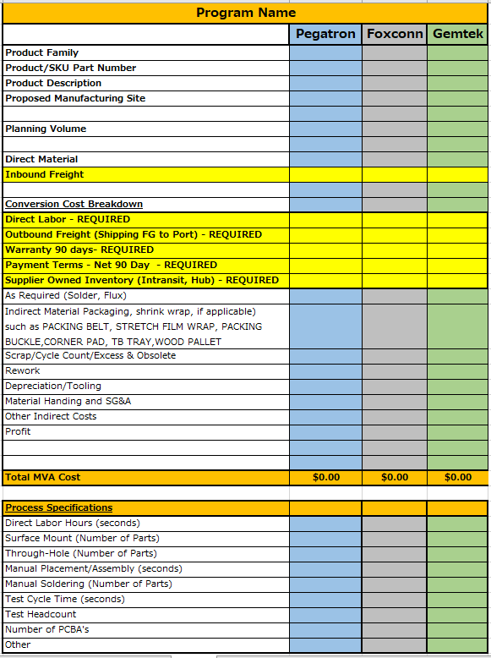
MVA Analysis (Detailed Cost Breakdown): Program Name
COS Only
SAMPLE

Slide 8
Capex Requirements (CoS Only as Applicable): Program Name
Capex -
Tool Capacity: 1M pieces per year (83K/month).
Total Capacity | Site | Spend | Comments
100k/yr - 8.7k/m - 420/day | Supplier 1 | $0 | 1. Re-use of the Xi6 line that will be in place at Foxconn. We would purchase enough equipment/fixtures to only utilize a very small amount of capacity. IP928 SPDIF function - need upgrade to add decoder + analog card ($1.5k/test) at Xi6 FAT station for testing. 2. Can not run the Xi6 and IP928 at the same time on the line, so the entire line would be devoted to one or the other product.
100k/yr - 8.7k/m - 420/day | Supplier 2 | $0 | 1. Assume a new line. Capital = $86,000 Expense = $164,000
100k/yr - 8.7k/m - 420/day | Supplier 3 | $0 | 1. Re-use of the proposed Xi6 line at Pegatron. We would purchase enough equipment/fixtures to only utilize a very small amount of capacity. IP928 SPDIF function - need upgrade to add decoder + analog card ($1.5k/test) at Xi6 FAT station for testing. 2. Can not run the Xi6 and IP928 at the same time on the line, so the entire line would be devoted to one or the other product.
100k/yr - 8.7k/m - 420/day | Supplier 4 | $0 | 1. Assume a new line. (Pegatron does not have a Xi6 line at this time so we assume a new line). Capital = $86,000 Expense = $164,000
SAMPLE

Slide 9
Capex Requirements (CoS Only as Applicable): Program Name
Tooling Summary
 |  |  | EMS 1 |  |  | EMS 2 |  |  | EMS 3
Part Number | Description | Part Type | Tooling Price | Mold Type | Supplier | Tooling Price | Mold Type | Supplier | Tooling Price | Mold Type | Supplier
123456 | Enclosure | Plastic - Molded | $0.0000 | 2 Cavity | Tongda | $0.0000 | 2 Cavity | Ningbo Sunrise | $0.0000 | 2 Cavity | Vasun, AIC
654321 | Enclosure | Plastic - Molded | $0.0000 | 2 Cavity | Tongda | $0.0000 | 2 Cavity | Ningbo Sunrise | $0.0000 | 2 Cavity | Vasun, AIC
456789 | SHLD, SHEET METAL | Metal - Stamping | $0.0000 | Progressive Die | Tongda | $0.0000 | Progressive Die | Ningbo Sunrise | $0.0000 | Progressive Die | Aliner
987654 | SHLD, SHEET METAL | Metal - Stamping | $0.0000 | Progressive Die | Tongda | $0.0000 | Progressive Die | Ningbo Sunrise | $0.0000 | Progressive Die | Aliner
321645 | SHLD, SHEET METAL | Metal - Stamping | $0.0000 | Progressive Die | Tongda | $0.0000 | Progressive Die | Ningbo Sunrise | $0.0000 | Progressive Die | Aliner
654987 | SHLD, SHEET METAL | Metal - Stamping | $0.0000 | Progressive Die | Tongda | $0.0000 | Progressive Die | Ningbo Sunrise | $0.0000 | Progressive Die | Aliner
111111 | SHLD, SHEET METAL | Metal - Stamping | $0.0000 | Progressive Die | Tongda | $0.0000 | Progressive Die | Ningbo Sunrise | $0.0000 | Progressive Die | Aliner
22222 | SHLD, SHEET METAL | Metal - Stamping | $0.0000 | Progressive Die | Tongda | $0.0000 | Progressive Die | Ningbo Sunrise | $0.0000 | Progressive Die | Aliner
3333 | HEATSPREADER | Metal - Stamping | $0.0000 | Progressive Die | Tongda | $0.0000 | Progressive Die | Ningbo Sunrise | $0.0000 | Progressive Die | Aliner
44444 | HSG | Metal - Stamping | $0.0000 | Progressive Die | Mustang | $0.0000 | Progressive Die | Ningbo Sunrise | $0.0000 | Progressive Die | Aliner
88888 | CVR, BOTTOM, SHEET METAL | Metal - Stamping | $0.0000 | Progressive Die | Mustang | $0.0000 | Progressive Die | Ningbo Sunrise | $0.0000 | Progressive Die | Aliner
Total Tooling Cost |  |  | $0.0000 |  |  | $0.0000 |  |  | $0.0000
SAMPLE
BCFE Status: Approved Oct 15, 2019

Slide 10
Review Board Recommendations: Program Name
Title | Name | Decision (Go, No Go, More Info)
Procurement | Dawn Green
Supplier Development
Comments/Additional Information Required
Example: Review and qualify second source AVL components.
Example: Develop soft tooling plan with Supplier
Example: Finalize Test Plan strategy.
Slide to be completed by Board Admin
X
Place ‘X’ by Final Recommendation
YES
NO
CONDITIONAL
IMPORTANT: GO with conditions must have conditions noted in action items list. Next Slide

Slide 11
Review Board Action Items: Program Name
Slide to be completed by Board Admin
Make sure to include any “Conditional Approval” Items here
Action Item | Responsible | Date | Due Date | Comments

